Slide 1
SYRIATEL CUSTOMER CHURN ANALYSIS DATA DRIVEN INSIGHTS FOR CUSTOMER LOYALTY BY VICKY GAKUO

Slide 2
CORE OBJECTIVE: IDENTIFY RISK, PRESERVE REVENUE
Objective: The aim is to focus on identifying the specific customer behaviors and service friction points that result in account cancellations (churn).
Goal: To provide a set of data-driven recommendations designed to help SyriaTel proactively intervene and retain high-value customers.

Slide 3
ANALYZING SYRIATEL DATA
SOURCE: SyriaTel Customer Churn Dataset (Cleaned and Feature-Engineered).
METRIC: The primary risk measure is Target Recall (Churn). This measures the model’s actual success in catching at-risk customers before they leave, rather than just looking at overall accuracy.

Slide 4
ANALYSIS AND KEY FINDINGS

Slide 5
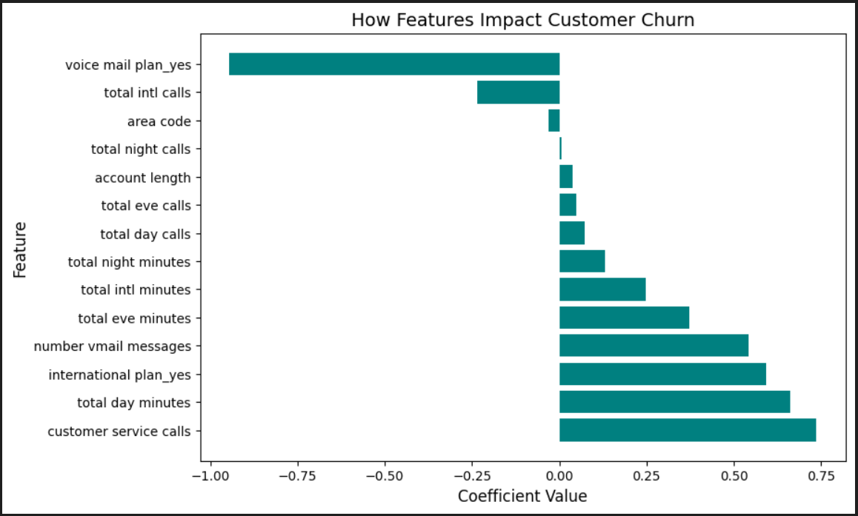
FINDING 1: THE SERVICE INTERACTION BREAKING POINT
Observation: Customer churn risk is most heavily influenced by the volume of Customer Service Calls.
Statistics: This feature emerged as the strongest positive predictor of churn. Each additional call represents an unresolved friction point that exponentially increases the probability of a customer leaving.

Slide 6
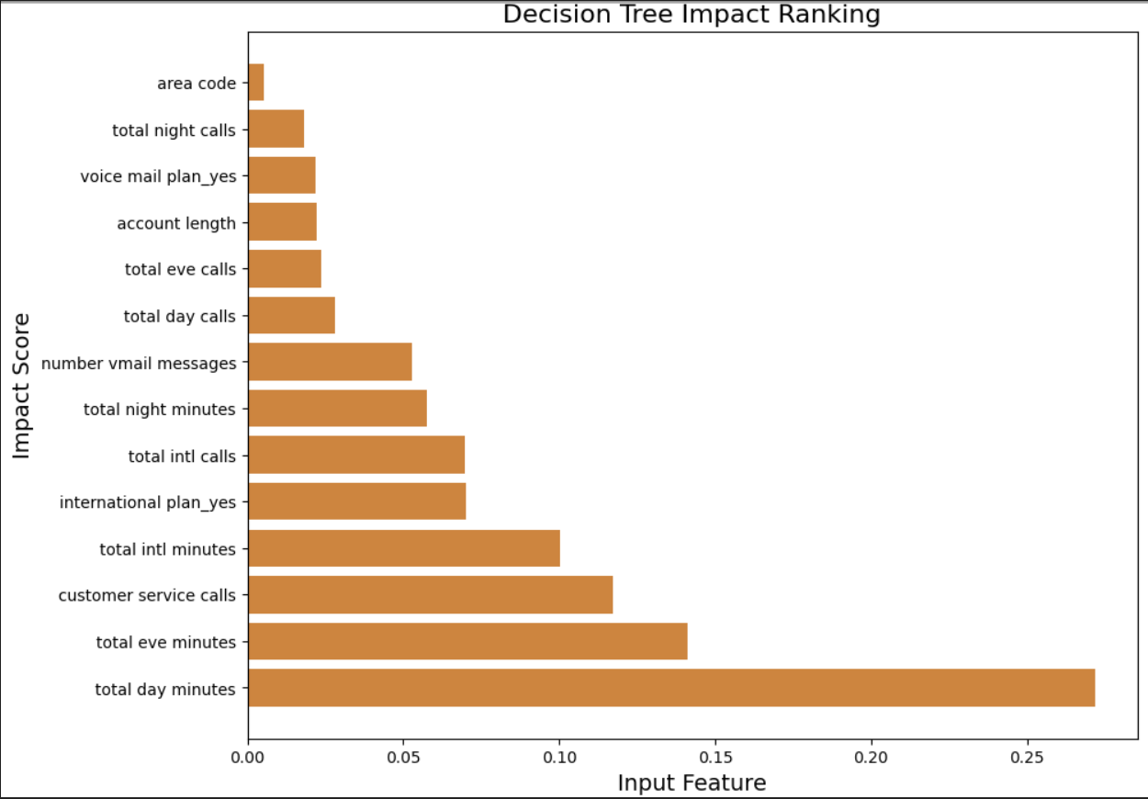
FINDING 2: THE HIGH-USAGE ATTRITION RISK
Observation: There is a high-volume risk associated with total day minutes
Statistic: SyriaTel most active daytime users are most likely to churn.

Slide 7
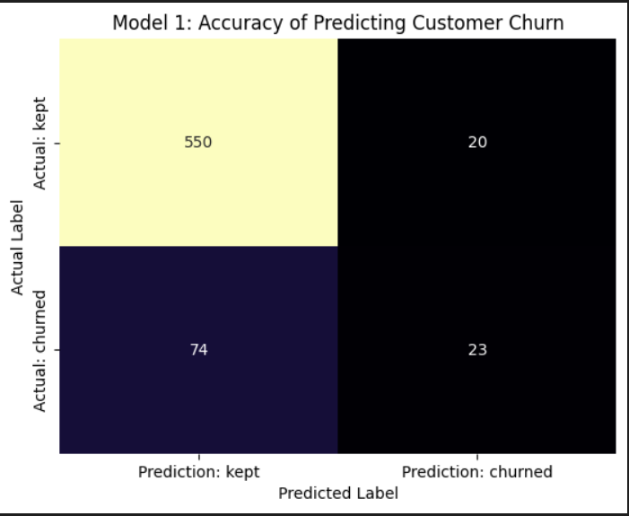
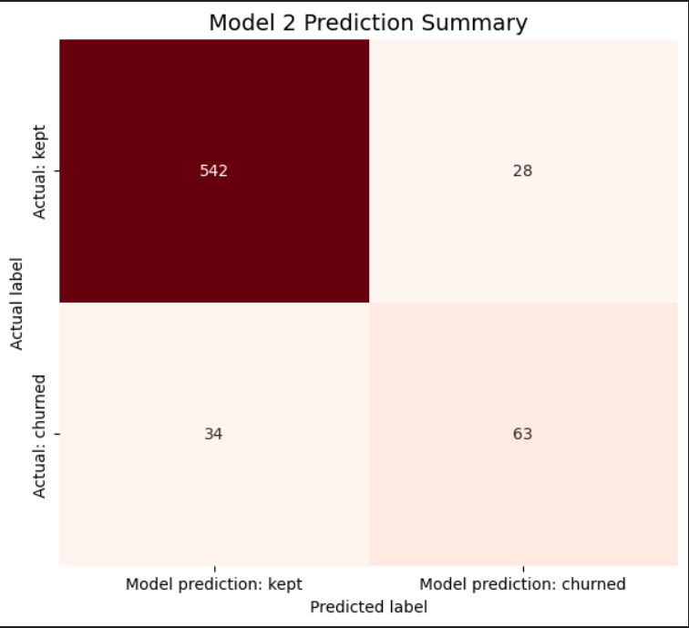
FINDING 3: MODEL OPTIMIZATION SUCCESS
Observation: The baseline Logistic Regression model suffered from an accuracy trap missing most of the at-risk customers.
Statistics: By switching to the Decision tree model, Recall improved from 24% to 65%.m

Slide 8
RECOMMENDATIONS (ACTIONABLE STRATEGY)

Slide 9
PROACTIVE SERVICE INTERVENTION
Action: Call an automated Loyalty Outreach to any customer with more than 3 service interactions in one billing cycle.
This will eliminate friction before the customer achieves the breaking point that was established in the data.

Slide 10
HIGH-VALUE RETENTION
Action: Develop a special loyalty program to top volume daytime users (Top 10% of Day Minutes).
Competitive pricing is directed to the particular group who is most likely to find better rates elsewhere.

Slide 11
MODEL DEPLOYMENT
Action: Embark the Decision Tree classification logic into the CRM.
Guarantees the marketing team concentrates funds on the 65% of the clientele who are actually at risk, as opposed to expenditure on the loyal accounts.

Slide 12
CONCLUSION
To sum up, these evidence-based recommendations will enable SyriaTel to shift to retention instead of damage control, which will greatly reduce the risk of losing high-value accounts.

Slide 13
Thank you

